Slide 1

t | i | c | k | e | t
r | a | r | e
a | i | r | p | o | r | t
v | o | y | a | g | e
e | x | i | t
l | o | v | e

Slide 2

The road doesn’t tell the traveler what lies ahead. ~ Bantu Proverb
If you are planning to travel where corn grows, you should take a sickle with you. ~ Ethiopian Proverb

Slide 3
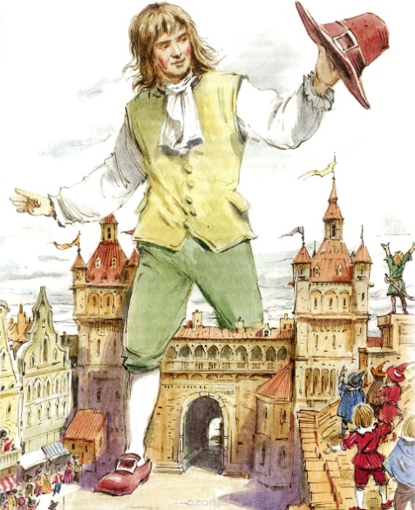



MODULE 8
Literature section
Culture Corner
Across the Curriculum section
Going Green section

Slide 4


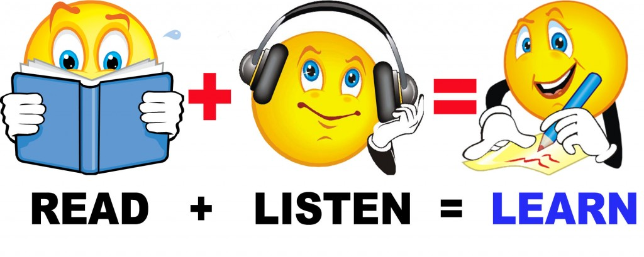


learn how to
listen, read and talk about
MODULE 8
practise
write

Slide 5


I think \ believe \ suppose \ consider In my opinion To my mind As far as I can see | module 8 is seems looks | absolutety very rather quite a bit | interesting amusing boring amusing frightening

Slide 6


